Slide 1

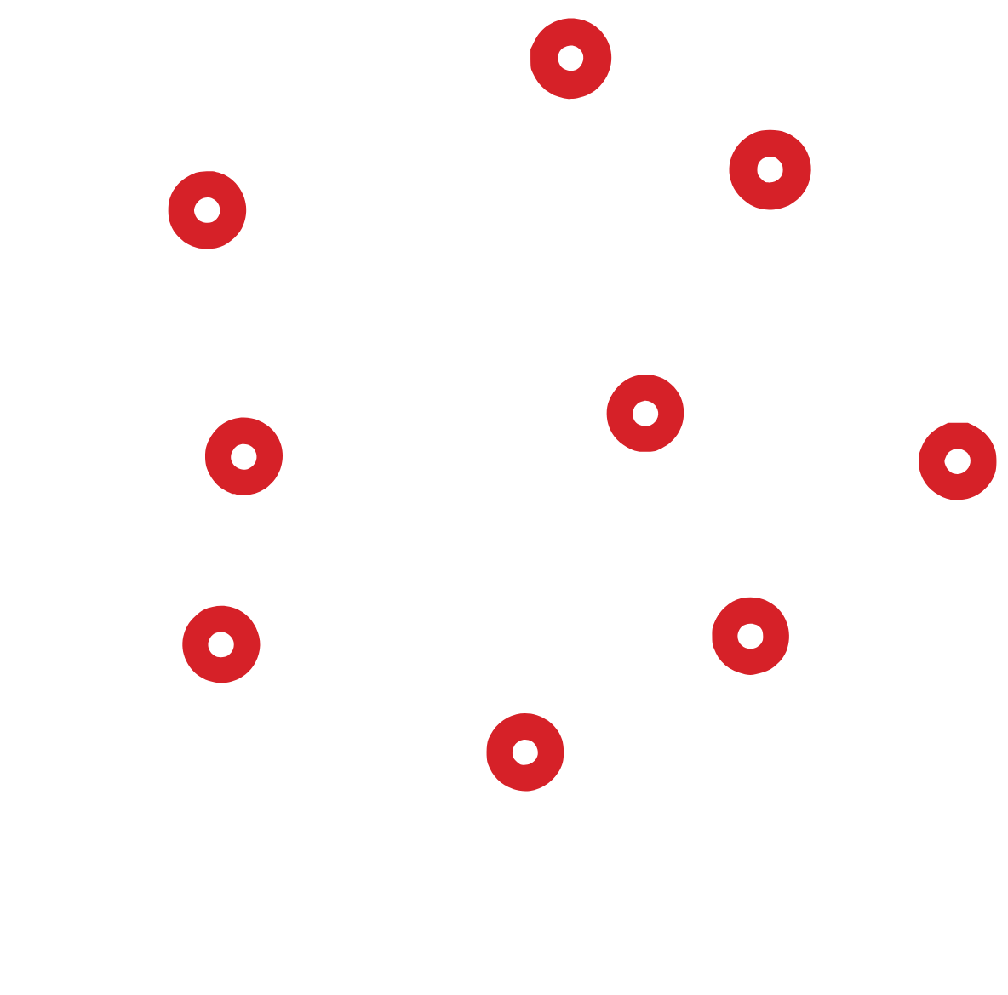
CARLETON AI SOCIETY · HTH III
Intro to
Machine
Learning
Demo code: github.com/carletonai/cais-workshop-hth-iii

Slide 2
Introduction

Slide 3

INTRODUCTION
Learning goals
01
Learn about the general field of AI
02
Learn about AI problems and techniques
Introduction to AI
Introduction to Machine Learning
Introduction to Neural Networks
03
Learn how to apply these techniques and concepts (with live demos)

Slide 4
Artificial intelligence
Machine learning
What is AI?
Neural
networks

Slide 5
PART 1 · AI
Intro to AI
rules.py
Very broad
if ejection_fraction < 30:
risk = "HIGH"
elif serum_creatinine > 1.5:
risk = "HIGH"
else:
risk = "low"
Rule-based systems (IF-ELSE statements)
Simple to implement

Slide 6
LIVE DEMO 01
1st code demo
Rule-based system: hand-written IF-ELSE rules
$
python demo1_rule_based.py

Slide 7

PART 2 · ML
Machine learning
Builds upon rule-based systems: instead of hand-writing the rules, it learns them from data (system evolves over time)
RULE-BASED · DEMO 1
Usually, make a prediction, calculate the loss (how wrong it was) and minimize it (for supervised learning)
Data
+
Rules
Answers
MACHINE LEARNING · DEMO 2
Examples of ML: Logistic/Linear regression, Decision trees (for classification and regression)
Data
+
Answers
Rules

Slide 8
PART 2 · ML
Supervised Machine Learning: Training, testing, validation
Normally you have a labelled dataset and want to create a model to learn from that dataset
Split data into train/valid/test sets
Training might not turn out great (iterative process)
Apply techniques to make sure your model doesn’t overfit/underfit (regularization, batch normalization, increase/decrease model parameters, hyperparameter tuning)
TRAIN · 60%
VALID · 20%
TEST · 20%
the model learns from this
tune settings
final exam, used once

Slide 9
LIVE DEMO 02
2nd code demo
Building off the 1st one: now the computer learns the rules
$
python demo2_machine_learning.py

Slide 10
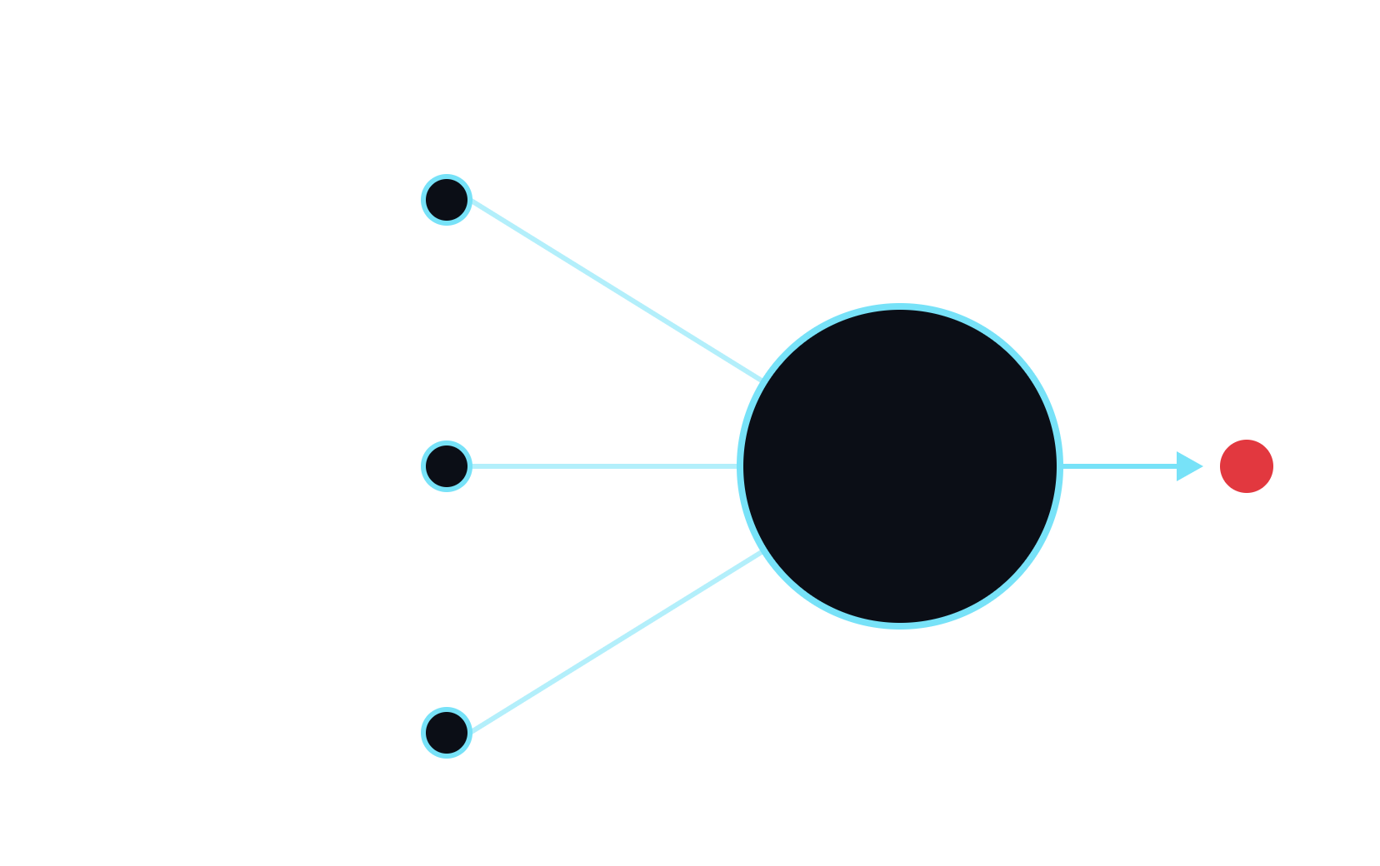
PART 3 · NEURAL NETWORKS
Artificial Neural Networks
ONE ARTIFICIAL NEURON
Loosely inspired by neurons in the biological brain (not an actual simulation of it)
age
w1
Uses machine learning to update weights/values
w2
Σ
ejection fraction
output
Applies same principles as ML (subset)
w3
weighted sum
+ activation
creatinine

Slide 11
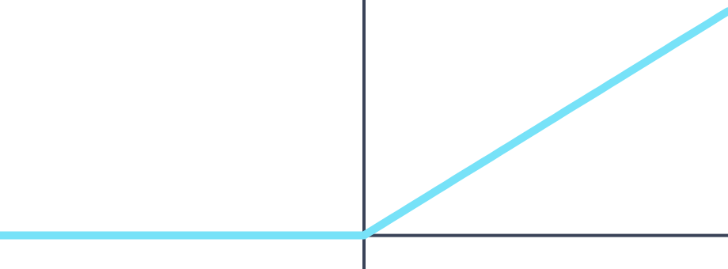
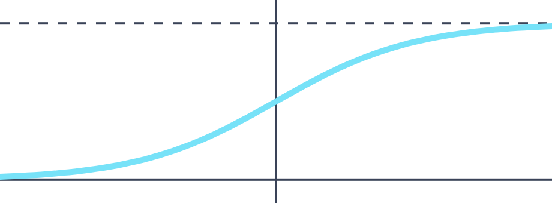
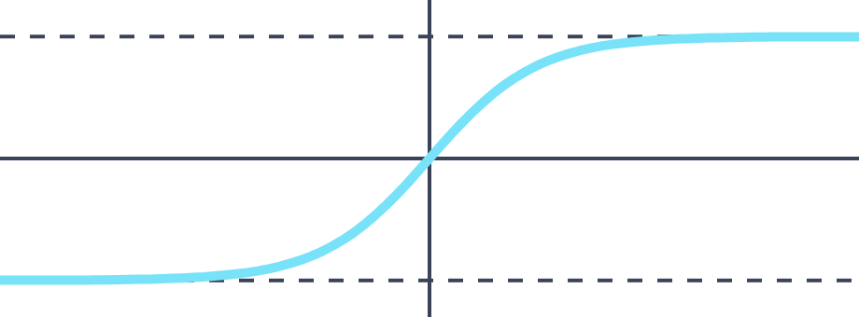
PART 3 · NEURAL NETWORKS
Activation functions
Determines how neurons fire/activate
Important because they add non-linearity: without them, stacking layers is still just one linear model
ReLU
Sigmoid
Tanh
max(0, x)
1 / (1 + e^−x)
tanh(x)
outputs 0 to ∞
outputs 0 to 1
outputs −1 to 1

Slide 12



PART 3 · NEURAL NETWORKS
Forward + Backpropagation (ML)
Forward pass: data flows through the model to make a prediction
Input
Model
Prediction
Loss
patient data
layers of weights
e.g. risk of death
how wrong was it?
Backpropagation: gradients of the loss flow back and update the weights. Then repeat.

Slide 13
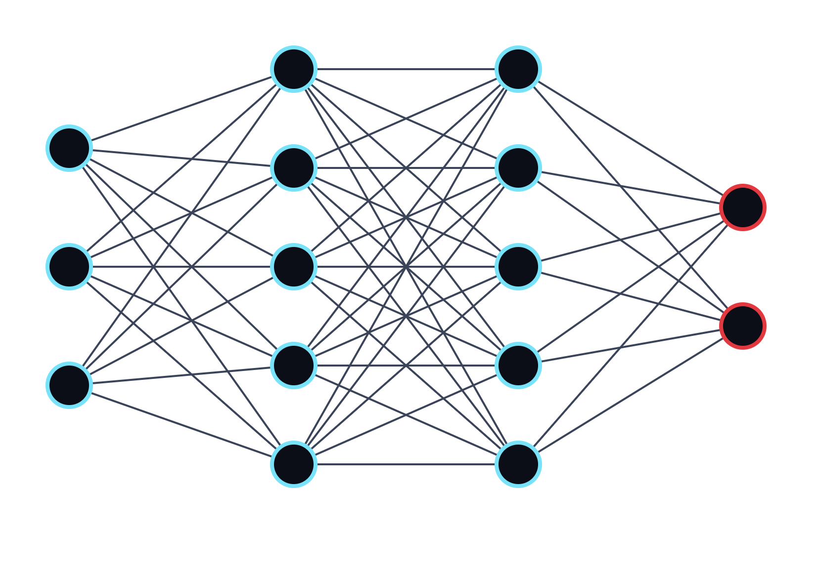
PART 3 · NEURAL NETWORKS
Multi-layer perceptron (MLP)
Feedforward neural network architecture
Every neuron in a layer connects to every neuron in the next layer (fully connected)
The most basic architecture
Easiest to use/implement
input
hidden
hidden
output

Slide 14


PART 3 · NEURAL NETWORKS
Recurrent Neural Networks (RNNs)
h = hidden state, carried to the next step
Were primarily used for sequential data: text, speech, time-series and forecasting
h1
h2
h3
RNN
RNN
RNN
RNN
Process a sequence one step at a time, carrying a hidden state (memory) forward
Today, transformer models have largely replaced them because of parallelization
the
cat
sat
down
step 1
step 2
step 3
step 4

Slide 15

PART 3 · NEURAL NETWORKS
Convolutional Neural Networks (CNNs)
Primarily used today for Computer Vision problems
Uses convolution operation with pooling, stride, etc. to extract features from an image (RGB)
Applying ML, learns the features and patterns of the data for prediction/classification in images
cat
image (RGB)
convolution
pooling
conv + pool
dense layer
prediction

Slide 16
LIVE DEMO 03
3rd demo
Neural networks
$

